Slide 1
Reverse Shell

Slide 2
Overview
File descriptor
Standard input and output devices
Redirecting standard input and output
How reverse shell works

Slide 3
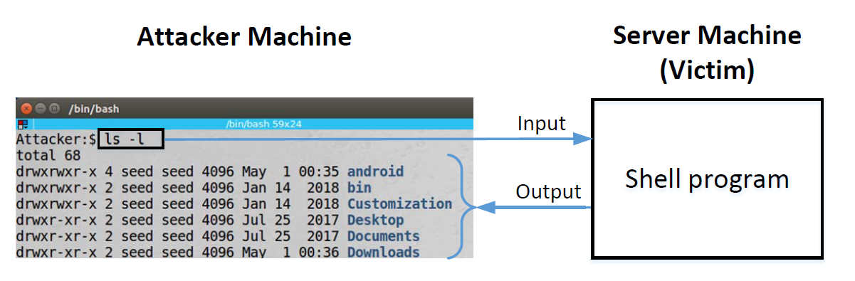
The Idea of Reverse Shell

Slide 4
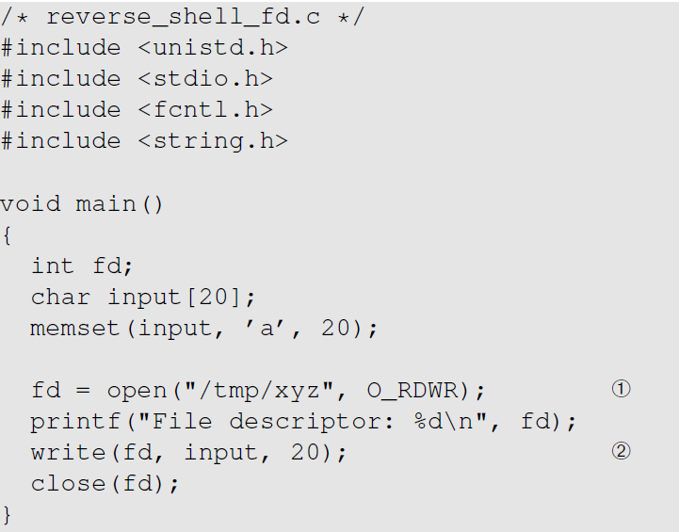
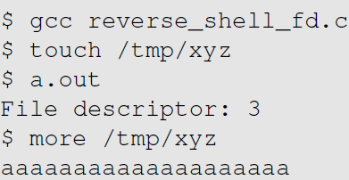
File Descriptor
Execution Result

Slide 5
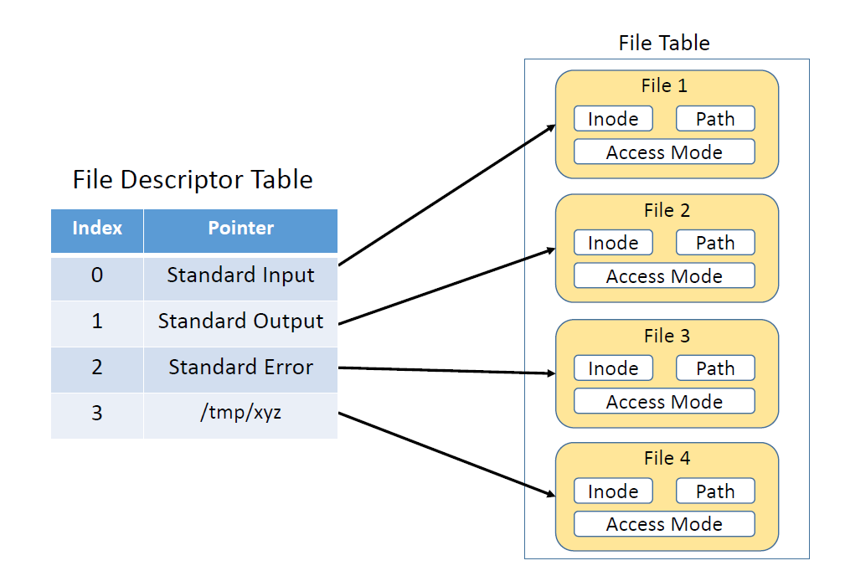
File Descriptor Table

Slide 6
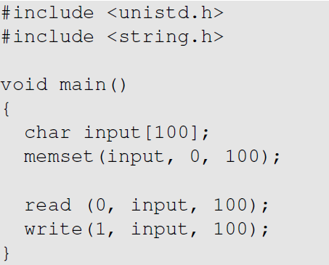
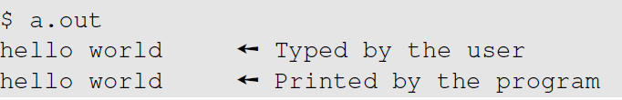
Standard I/O Devices
Execution Result

Slide 7
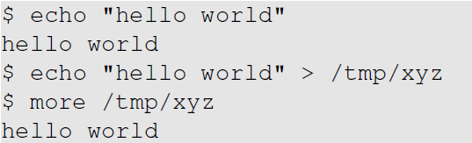
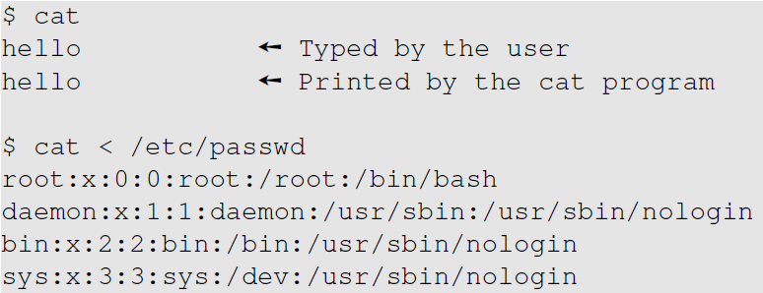
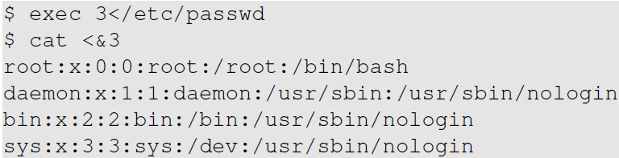
Redirection
An example
Redirecting to file
Redirecting to file descriptor

Slide 8
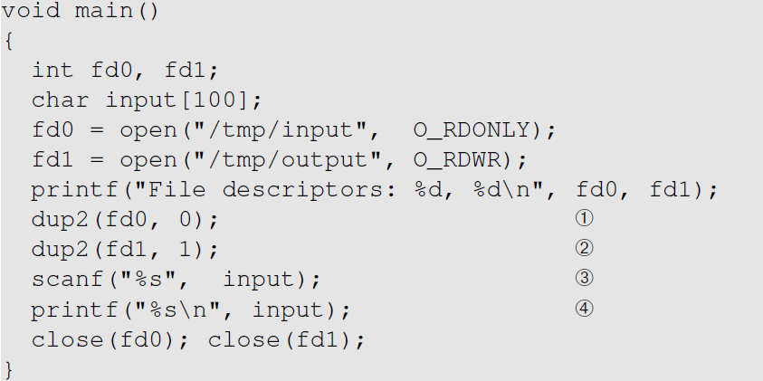
How Is Redirection Implemented?
Creates a copy of the file descriptor oldfp, and then assign newfd as the new file descriptor.

Slide 9
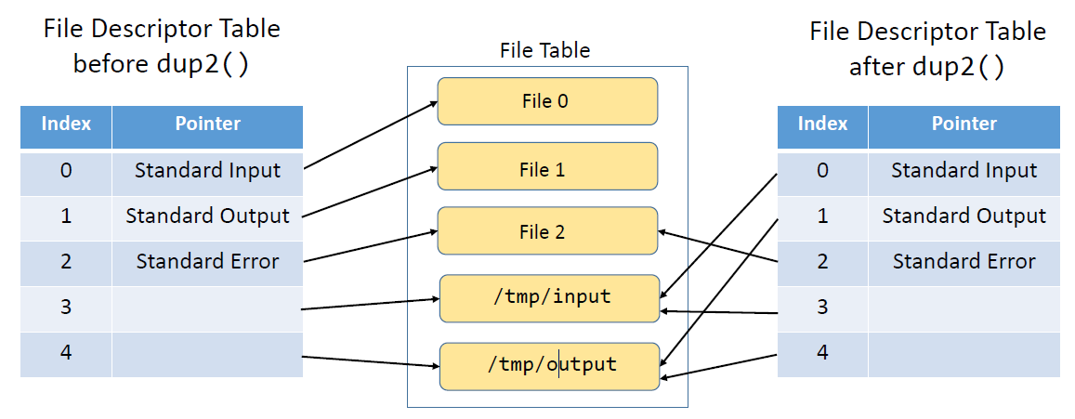
The Change of File Descriptor Table

Slide 10
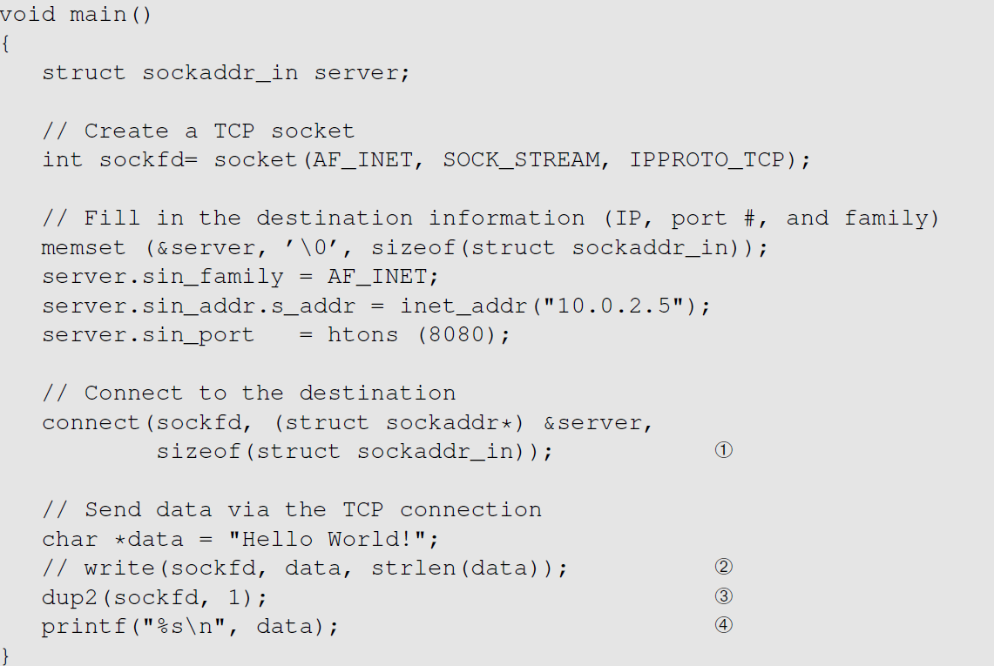
Redirecting Output to TCP Connections

Slide 11
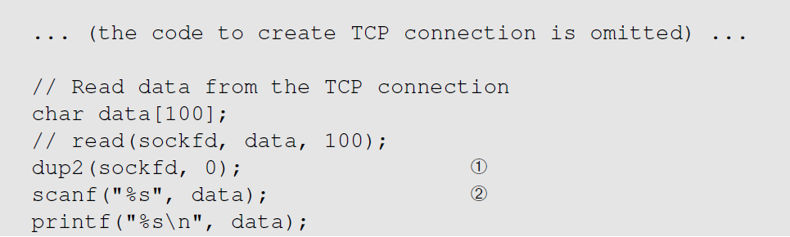
Redirecting Input to TCP Connections

Slide 12
Redirecting to TCP from Shell
Redirecting Input
Redirecting Output
Running a TCP server on 10.0.2.5
$ nc –l 9090

Slide 13
Note
/dev/tcp is not a real folder: it dos not exist
It is a built-in virtual file/folder for bash only
Redirection to /dev/tcp/… can only be done inside bash

Slide 14
Reverse Shell Overview

Slide 15
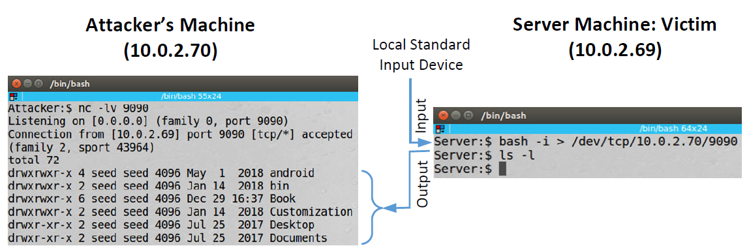
Redirecting Standard Output
On Attacker Machine (10.0.2.70)
On Server Machine

Slide 16
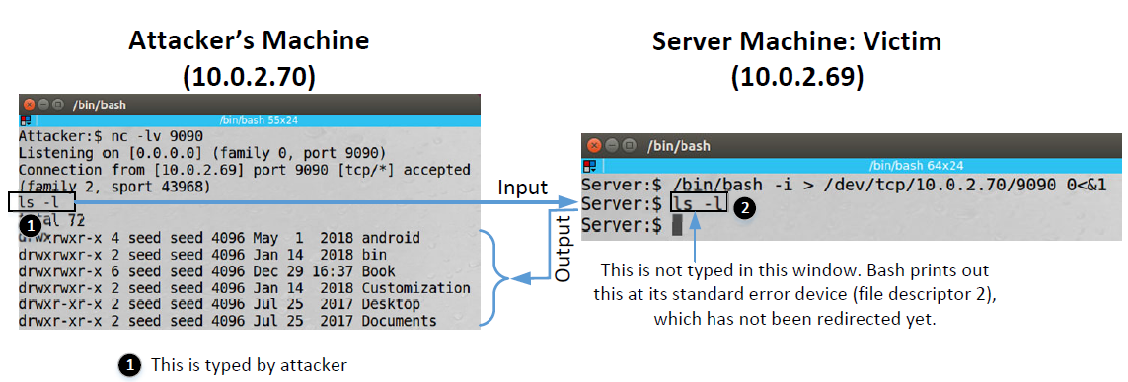
Redirecting Standard Input & Output
On Server Machine

Slide 17
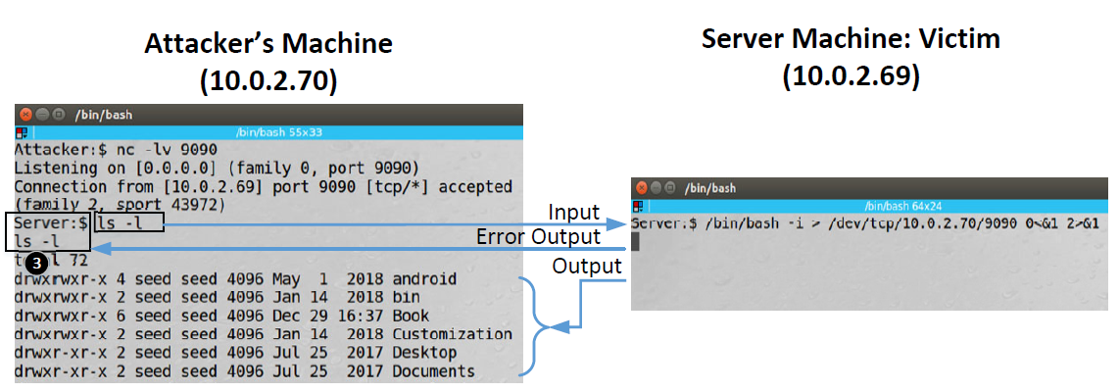
Redirecting Standard Error, Input, & Output
On Server Machine

Slide 18
Reverse Shell via Code Injection
Reverse shell is executed via injected code
Can’t assume that the target machine runs bash
Run bash first:

Slide 19
Summary
Reverse shell works by redirecting shell program’s input/output
Input and output of a program can be redirected to a TCP connection
The other end of the TCP connection is attacker
It is a widely used technique by attackers

